Slide 1
RDS 帳戶管理流程畫面

Slide 2


Desktop Access
RDS Program
Admin (Executive) Account
Notes:
需要安裝兩個程式
RDS遠端連線偵錯程式
RDS admin 主管Account Management程式
(需要程式ACCESS的圖，兩個)

Slide 3
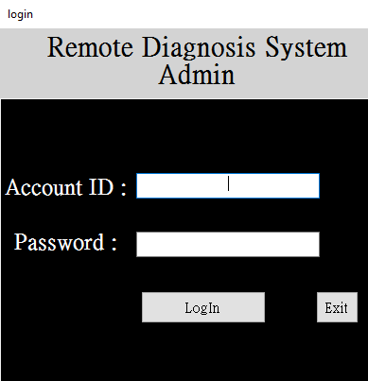
Forget Password
Notes:
Admin 程式安裝完成後，需要用Account: admin, Password: 12345 (default 設定)登入
登入之後Supervisor account的頁面需要選擇Security Question和建立答案
當要登入RDS admin忘記密碼的時候，可以在同一個畫面按下 “Forget password”，回答Security Questions (會自動調出問題)後 ，重新設定帳號密碼，就可以登入
原先忘記的密碼會自動被刷新

Slide 4
Forget Password
Notes:
Account ID + Password 都忘記
可以空白不填寫
直接按 Forget Password
回答問題
重新建立帳號密碼

Slide 5
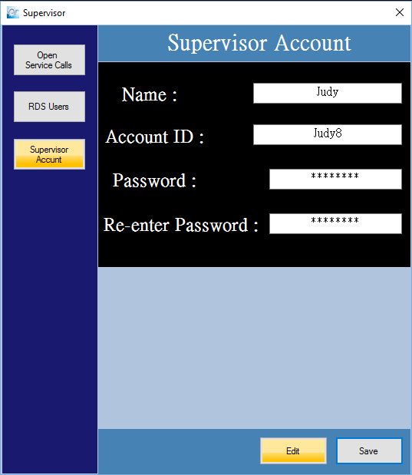
Security Question
Answer
(有四個問題選擇)
Notes:
選擇 Security Questions，建立Answer
Total 4 Security Questions
What was your favorite place to visit as a child?
In what city were you born?
What is your father’s middle name?
What is your favorite actor, musician, or artist?

Slide 6
Security Question: In what city were you born?
Answer to Q1:
Taipei City
ERROR !
Enter
Notes:
如果回答錯誤會留在同一頁，視窗中會出現Error符號

Slide 7
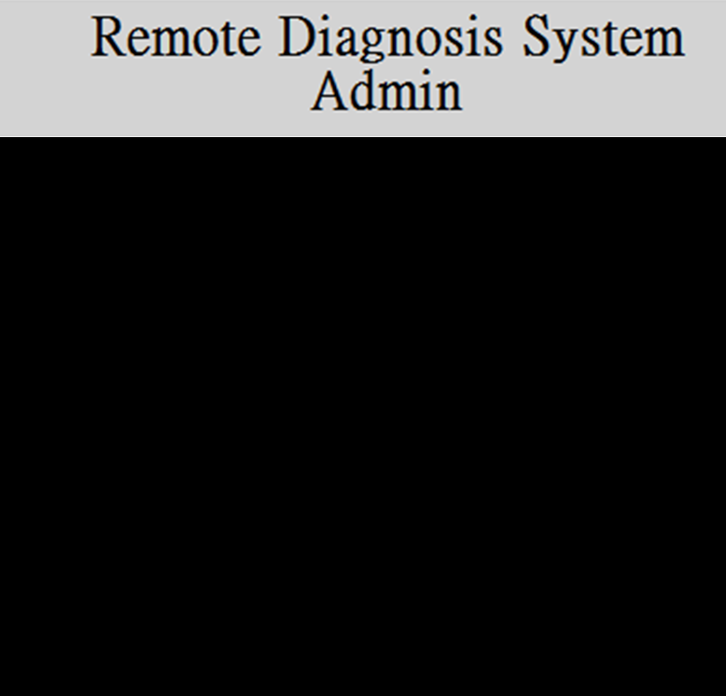
New Account ID:
New Password:
Re-enter Password:
12345678
12345678
12345678
Enter
Notes:
建立新密碼

Slide 8
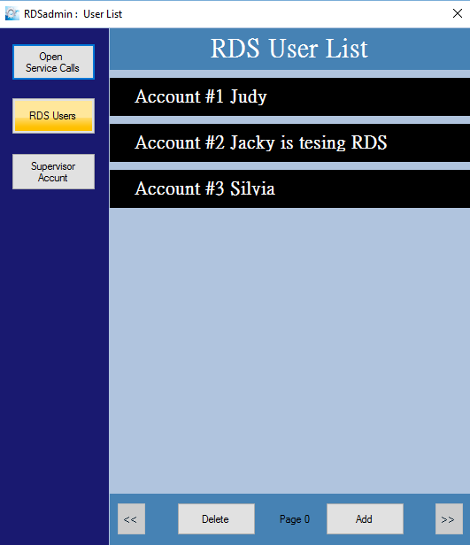

Slide 9
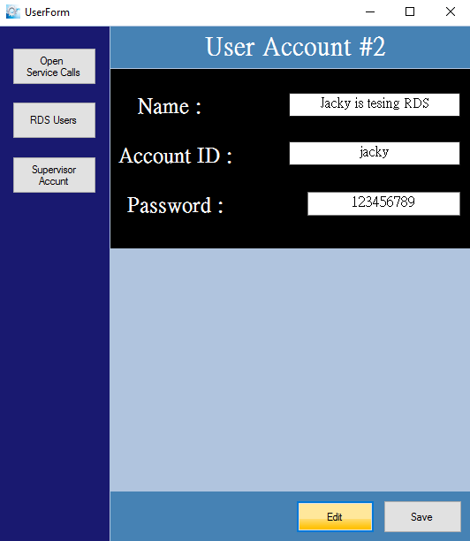

Slide 10
Open Service Calls
Open
Service Calls
PPMX6J_012816_1_S1
RDS User
XDFR9R_012816_1_S2
Executive Account
SJGO0S_012916_1_S1
UID = DLCT2SZP6WUAUNPPMX6J
Report 編碼原則: UID後6號碼 + 日期(月日年) + 此用戶在當天的第幾筆,
Example: PPMX6J_012816_3
工單編碼: Report 編碼 + P(哪位操作員)+S (今天第幾筆工單), Example: PPMX6J_012816_1_P01_S02
每一個Report 都有編碼
但不是每一個Report都有編碼 +工單號碼
需要工單的 Report 會有Report編碼 + 工單號碼
工單 and RDS Report是同一份文件
Notes:
UID = DLCT2SZP6WUAUNPPMX6J
Report 編碼原則: UID後6號碼 + 日期(月日年) + 此用戶在當天的第幾筆,
Example: PPMX6J_012816_3
工單編碼: Report 編碼 + S (今天第幾筆工單), Example: PPMX6J_012816_1_S2
每一個Report 都有編碼
但不是每一個Report都有編碼 +工單號碼
需要工單的 Report 會有Report編碼 + 工單號碼
工單 and RDS Report是同一份文件

Slide 11
d
Open
Service Calls
UID # Owner
DLCT2SZP6WUAUNPPMX6J
Mr. James Smith
Spa Serial # Hot Tub Model #
2384230985485
J-222
RDS User
Date CS REP.
2016/01/28
4 – Victor Rajah
Executive Account
Error Message
Possible Root Causes
Pump 2 Defect
Equipments for On-Site Service
Pump 2, Filter Cartridge, Topside, Board, Fuse, Voltmeter, Ohmmeter, Ammeter
Back
RDS Report
Notes:
Open Service Call 的欄位和History進去看到的欄位一樣
只是History裡面有 “ Service Call #” & “ Parts Replaced”. 但是 Open Service Call 裡面沒有
按下RDS Report可以調出完整的Report

Slide 12
Remote Diagnosis System
Version 1.22
Account #
JSPA@665
Password #
******
Log in
Notes:
客服人員忘記密碼的話就問主管
主管忘記帳號或是密碼可以到RDS admin重新設定

Slide 13
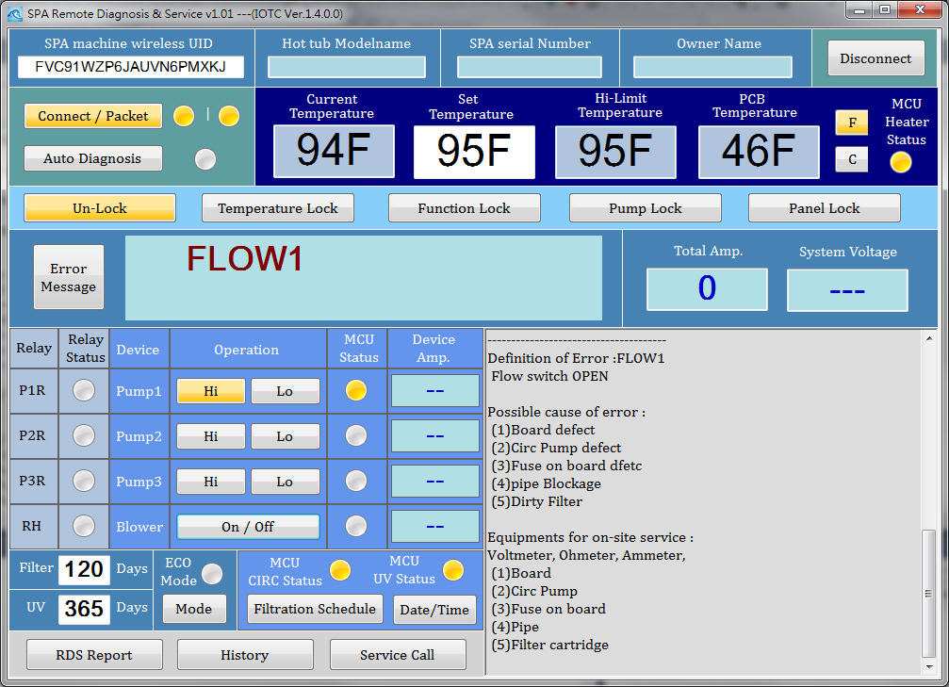

Slide 14
Note Area for Customer Service to enter

Slide 15
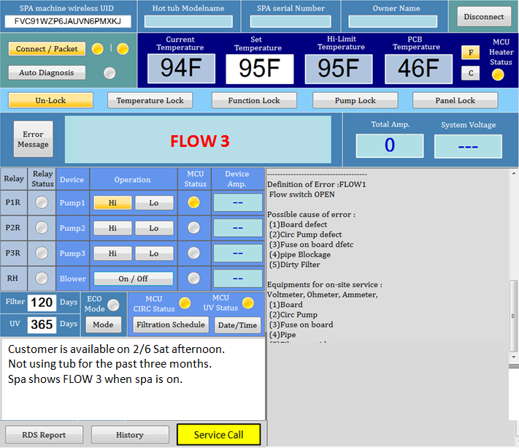

Slide 16
FLOW 3
Customer is available on 2/6 Sat afternoon.
Not using tub for the past three months.
Spa shows FLOW 3 when spa is on.
Notes:
RDS介面有一個視窗給客服人員Take Note
(需要另外開視窗才可以take note嗎?)

Slide 17
History

Slide 19
UID #
Spa Serial # Hot Tub Model #
2384230985485
J-222
23498-239847
Owner
Mr. James Smith
2343-9398264
Mr. James Smith
2015/01/05
Date CR Person
2015/03/23
2015/09/02
4 – Victor Rajah
2015/05/15
Error Message
-------------------------------------------
2015/07/01
2015/07/29
Possible Root Causes
Pump 2 Defect
2015/09/02
Equipments for On-Site Service
2015/12/04
Pump 2, Filter Cartridge, Topside, Board, Fuse, Voltmeter, Ohmmeter, Ammeter
Service #
SJGO0S_20160129_1_S1
Replaced Parts
Pump 2
Operation Record
RDS Report
Save
Notes:
在RDS介面輸入UID
按下History按鍵，紀錄會以日期分類顯示該UID的RDS歷史資料
每一筆History紀錄 (by date)都有RDS Report和操作動作流程可顯示 (畫面看後面頁數)
RDS Report按下會出現新視窗，文件檔顯示RDS 完整Report

Slide 20
UID #
d
Spa Serial # Hot Tub Model #
2384230985485
J-222
23498-239847
Owner
Mr. James Smith
2343-9398264
Mr. James Smith
2015/01/05
Date CR Person
2015/03/23
2015/03/23
4 – Victor Rajah
2015/05/15
Error Message
FLOW 3
2015/07/01
2015/07/29
Possible Root Causes
Flow Switch Defect, Board Defect
2015/09/02
Equipments for On-Site Service
2015/12/04
Pump 2, Filter Cartridge, Topside, Board, Fuse, Voltmeter, Ohmmeter, Ammeter
Service #
XDFR9R_20160128_1_S2
Replaced Parts
Flow Switch
Operation Record
RDS Report
Edit
Notes:
History顯示日期由新到舊

Slide 21
Operation Record

Slide 22
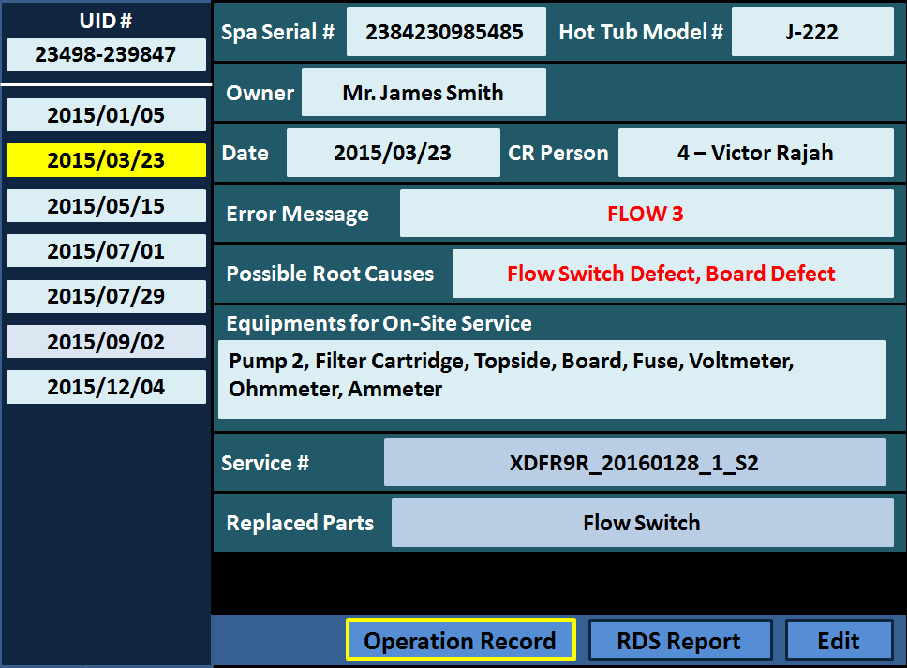
時間
10:33
10:35
10:36
10:40
10:48
操作動作
Log in RDS
Connect
Note entering…
Auto-Diagnosis starts… (因為操作流程固定，所以不用顯示細節)
Auto-Diagnosis completes
Back
Notes:
Operation Record 點進去後，原本顯示history畫面改由顯示操作動作流程
左排為時間，右排為動作流程
Auto Diagnosis流程是固定所以不用顯示操作細節
檢測完成之後的操作動作會繼續記錄
操作動作由 UID Connect成功之後開始記錄

Slide 23
Service Call

Slide 24
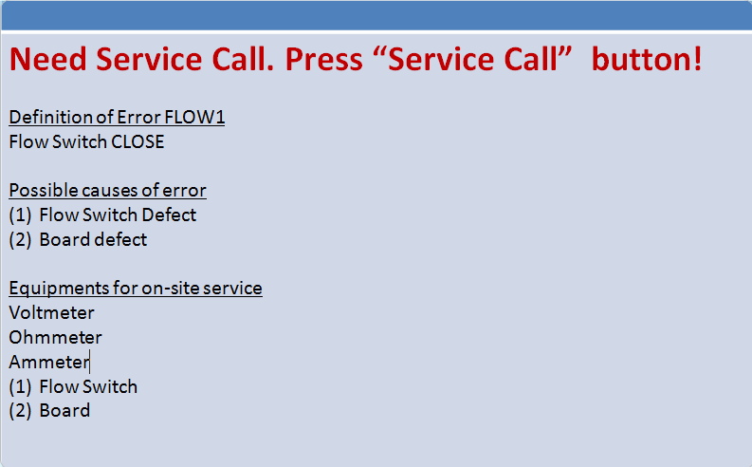
Service Call
Notes:
輸入UID + 上排資訊 →Connect →Auto-Diagnosis → Press Service Call if needed → Disconnect
Ex, 如果出現Flow 1, 按下Auto-Diagnosis也不會有動作, 左下角視窗在出現 Error Definition的時候會有 Need Service Call的Instruction.
按下Service Call之後，Button會呈現黃色，代表Service call generated.

Slide 25
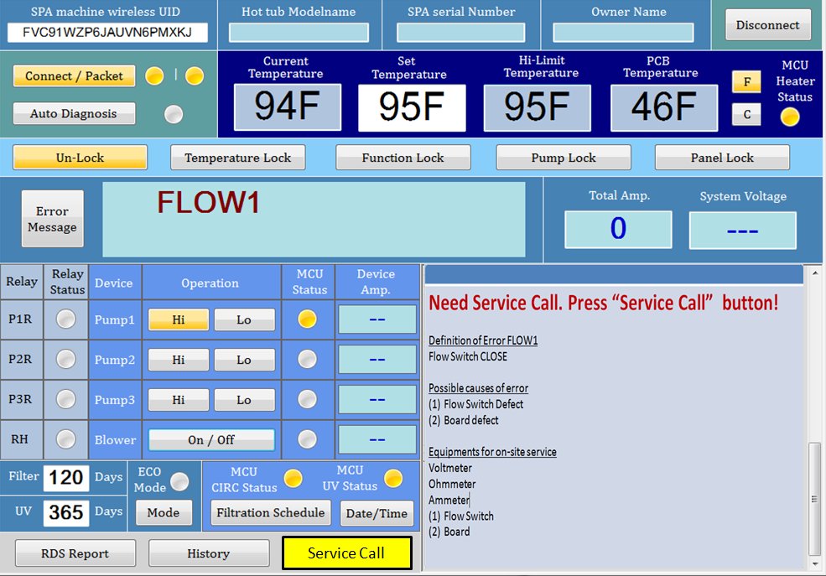
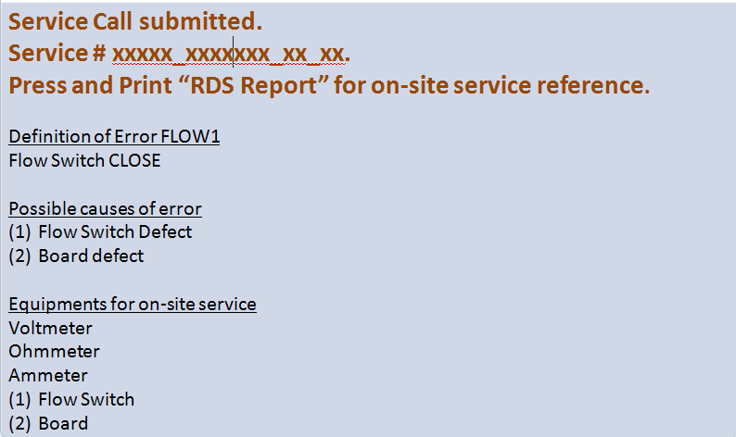

Slide 26
Note Area for Customer Service to enter

Slide 28
FLOW 3
Customer is available on 2/6 Sat afternoon.
Not using tub for the past three months.
Spa shows FLOW 3 when spa is on.

Slide 29
Service Lock (To replace function lock)

Slide 30
Service Lock
Temperature Lock
Notes:
Service Lock = Everything, including circ pump will hold to 120min, for customer to change filter etc.
Service Lock 放最左邊

Slide 31
Error Message Default Message
SSO/SSR/HSO/HSR/PBSO/PBSR
LOKA/LOKP/LOKE/LOKS/FSO/FSC
FSO1/R1/R2/R3/RH/WHO/WCL/
WICE/CBB/FEX/PBHO

Slide 32
WSO
Definition of Error WSO Water temperature sensor OPEN Possible causes of error Water temperature sensor defect/ Board defect/ Topside Equipments for on-site service Voltmeter/ Ohmmeter/ Ammeter/ Water temperature sensor/ Board/ Topside

Slide 33
WSS
Definition of Error WSS Water temperature sensor SHORT Possible causes of error Water temperature sensor defect/ Board defect/ Topside Equipments for on-site service Voltmeter/ Ohmmeter/ Ammeter/ Water temperature sensor/ Board/ Topside

Slide 34
HSO
Definition of Error HSO Hi-Limit temperature sensor OPEN Possible causes of error Hi-Limit temperature sensor defect/ Board defect Equipments for on-site service Voltmeter/ Ohmmeter/ Ammeter/ Hi-Limit temperature sensor with Heater/ Board

Slide 35
HSS
Definition of Error HSS Hi-Limit temperature sensor SHORT Possible causes of error Hi-Limit temperature sensor defect/ Board defect. Equipments for on-site service Voltmeter/ Ohmmeter/ Ammeter/ Hi-Limit temperature sensor with Heater/ Board

Slide 36
PSO
Definition of Error PSO PCB temperature sensor OPEN Possible causes of error Board defect. Equipments for on-site service Voltmeter/ Ohmmeter/ Ammeter/ Board

Slide 37
PSS
Definition of Error PSS PCB temperature sensor SHORT Possible causes of error Board defect. Equipments for on-site service Voltmeter/ Ohmmeter/ Ammeter/ Board

Slide 38
LOKA
Definition of Error LOKA Panel Locked. All functions locked. Solution Please unlock panel to operate manually.

Slide 39
LOKP
Definition of Error LOKP Pump Locked Solution Please unlock to operate pump manually.

Slide 40
LOKE
Definition of Error LOKE Temperature Locked Solution Please unlock to adjust temperature manually.

Slide 41
LOKS
Definition of Error LOKS Service Locked All pump including circ. Pump and heater will be locked for 120 minutes for any service or filter replacement. Solution Please unlock to operate.

Slide 42
FSO
Definition of Error FSO Flow Switch OPEN Please follow below steps to troubleshoot error Is water level above every jets? Dirty filter can cause this error. Is filter dirty? Is filter cartridge replaced? Are all jets opened and water flow appears normal? Air locked pump is common when a spa has been drained and re-filled. Are all pumps plugged in? and fuse is not blown? Is flow switch replaced recently? All possible causes of error Flow Switch defect/ Circ. Pump defect/ Fuse on board defect/ Board defect/ Pipe blockage/ Dirty Filter Equipments for on-site service Voltmeter/ Ohmmeter/ Ammeter/ Board / Circ. Pump/ Fuse on board / Flow Switch / Pipe / Filter Cartridge/ Jet
Notes:
Definition of Error FSO
Flow Switch OPEN
Please follow below steps to troubleshoot error
Is water level above every jets?
Dirty filter can cause this error. Is filter dirty? Is filter cartridge replaced?
Are all jets opened and water flow appears normal? Airlocked pump is common when a spa has been drained and re-filled.
Are all pumps plugged in? and fuse is not blown?
Is flow switch replaced recently?
All possible causes of error
Flow Switch defect/ Circ Pump defect/ Fuse on board defect/ Board defect/ Pipe blockage/ Dirty Filter
Equipments for on-site service
Voltmeter/ Ohmmeter/ Ammeter/ Board / Circ Pump/ Fuse on board / Flow Switch / Pipe / Filter Cartridge/ Jet

Slide 43
FSC
Definition of Error FSC Flow Switch CLOSE Please follow below steps to troubleshoot error (1) Is flow switch adjusted correctly? Possible causes of error Flow Switch Defect/ Board defect/ Circ. Pump Defect Equipments for on-site service Voltmeter/ Ohmmeter/ Ammeter/ Flow Switch/ Board/ Circ. Pump

Slide 44
FSC1
Definition of Error FSC1 Flow Switch CLOSE Please follow below steps to troubleshoot error (1) Is flow switch adjusted correctly? Possible causes of error Flow Switch Defect/ Board defect/ Circ. Pump Defect Equipments for on-site service Voltmeter/ Ohmmeter/ Ammeter/ Flow Switch / Board / Circ. Pump

Slide 45
R1
Definition of Error R1 Pump 1 high speed relay defect Possible causes of error Board defect. Equipments for on-site service Voltmeter/ Ohmmeter/ Ammeter/ Board

Slide 46
R2
Definition of Error R2 Pump 2 high speed relay defect Possible causes of error Board defect. Equipments for on-site service Voltmeter/ Ohmmeter/ Ammeter/ Board

Slide 47
R3
Definition of Error R3 Pump 3 high speed relay defect Possible causes of error Board defect. Equipments for on-site service Voltmeter/ Ohmmeter/ Ammeter/ Board

Slide 48
RH
Definition of Error RH Heater relay defect Possible causes of error Board defect. Equipments for on-site service Voltmeter/ Ohmmeter/ Ammeter/ Board

Slide 49
WOH
Definition of Error WOH Water is over heated. Water temperature is equal or exceed 112F , Or Hi-Limit temperature sensor is equal or exceed 116F. Please follow below steps to troubleshoot error Is SPA just filled with hot water? If yes, please allow water to cool. Heat may be caused by excessive filtration, please turn filtration down to 2-4 hours a day. Heat may caused by extreme hot weather, need a summer door for cabinet to cool down. All Possible causes of error Water temperature sensor defect/ Hi-Limit temperature sensor defect/ Board defect/ Topside Equipments for on-site service Voltmeter/ Ohmmeter/ Ammeter/ Water temperature sensor defect/ Hi-Limit temperature sensor/ Board/ Topside
Notes:
Definition of Error WOH
Water is too hot.
Water temperature is equal or exceed 112F or,
Hi-Limit temperature sensor is equal or exceed 116F
Please follow below steps to troubleshoot error
Is spa just filled with hot water? If yes, please allow water to cool.
Heat may be caused by excessive filtration, please turn filtration down to 2-4 hours a day.
Heat may caused by extreme hot weather, need a summer door for cabinet to cool down.
All Possible causes of error
Water temperature sensor defect/ Hi-Limit temperature sensor defect/ Board defect/ Topside
Equipments for on-site service
Voltmeter/ Ohmmeter/ Ammeter/ Water temperature sensor defect/ Hi-Limit temperature sensor/ Board/ Topside

Slide 50
WCL
Definition of Error WCL Water is cool Actual water temperature is 20F lower than set temperature. Please follow below steps to troubleshoot error Is SPA just filled with cold water? Is circulation pump on? Is weather too cold? Possible causes of error Hi-limit temperature sensor defect/ Water temperature sensor defect/ Board defect/ Circ. Pump defect. Equipments for on-site service Voltmeter/ Ohmmeter/ Ammeter/ Hi-limit temperature sensor/ Water temperature sensor/ Circ. Pump/ Board
Notes:
Definition of Error WCL
Water is too cold
Actual water temperature is 20F lower than set temperature.
Please follow below steps to troubleshoot error
Is Spa just filled with cold water?
Is circulation pump on?
Is weather too cold?
Possible causes of error
Hi-limit temperature sensor defect/ Water temperature sensor defect/ Board defect/ Pump defect.
Equipments for on-site service
Voltmeter/ Ohmmeter/ Ammeter/ Hi-limit temperature sensor/ Water temperature sensor/ Pump/ Board

Slide 51
WICE
Definition of Error WICE Water is too cold. Water temperature or hi-limit temperature is lower than 65F. Please follow below steps to troubleshoot error Is SPA filled with cold water? Is circulation pump on? Is weather too cold? Possible causes of error Hi-limit temperature sensor defect/ Water temperature sensor defect/ Board defect/ Circ. Pump defect. Equipments for on-site service Voltmeter/ Ohmmeter/ Ammeter/ Hi-limit temperature sensor/ Water temperature sensor/ Circ. Pump/ Board
Notes:
Definition of Error WICE
Water too cold
Water temperature and hi-limit temperature is lower than 65F
Please follow below steps to troubleshoot error
Is Spa filled with cold water?
Is circulation pump on?
Is weather too cold?
Possible causes of error
Hi-limit temperature sensor defect/ Water temperature sensor defect/ Board defect/ Pump defect.
Equipments for on-site service
Voltmeter/ Ohmmeter/ Ammeter/ Hi-limit temperature sensor/ Water temperature sensor/ Pump/ Board

Slide 52
WWD
Definition of Error WWD Water is too hot. Hi-Limit temperature sensor is equal or exceed 120F. Please follow below steps to troubleshoot error Is SPA just filled with hot water? If yes, please allow water to cool. Heat may be caused by excessive filtration, please turn filtration down to 2-4 hours a day. Heat may caused by extreme hot weather, need a summer door for cabinet to cool down. All Possible causes of error Water temperature sensor defect/ Hi-Limit temperature sensor defect/ Board defect/ Topside Equipments for on-site service Voltmeter/ Ohmmeter/ Ammeter/ Water temperature sensor defect/ Hi-Limit temperature sensor/ Board/ Topside
Notes:
Definition of Error WWD
Water too hot.
Water temperature is equal or exceed 112F or,
Hi-Limit temperature sensor is equal or exceed 116F
Please follow below steps to troubleshoot error
Is spa just filled with hot water? If yes, please allow water to cool.
Heat may be caused by excessive filtration, please turn filtration down to 2-4 hours a day.
Heat may caused by extreme hot weather, need a summer door for cabinet to cool down.
All Possible causes of error
Water temperature sensor defect/ Hi-Limit temperature sensor defect/ Board defect/ Topside
Equipments for on-site service
Voltmeter/ Ohmmeter/ Ammeter/ Water temperature sensor defect/ Hi-Limit temperature sensor/ Board/ Topside

Slide 53
CBB
Definition of Error CBB UV Light usage expired. Possible causes of error UV light usage expired/ Board defect/ Topside Equipments for on-site service Voltmeter/ Ohmmeter/ Ammeter/ UV light/ Board/ Topside

Slide 54
FEX
Definition of Error FEX Filter usage expired. Possible causes of error Filter usage expired/ Board defect/ Topside Equipments for on-site service Voltmeter/ Ohmmeter/ Ammeter/ Filter Cartridge/ Board/ Topside

Slide 55
PCBH
Definition of Error PCBH PCB Temperature exceeds 180F. Possible causes of error Board defect Equipments for on-site service Voltmeter/ Ohmmeter/ Ammeter/ Board

